Slide 1
Before we start
Please complete the Pre-Assessment

Slide 2
Military Occupation Codes (MOC) Crosswalk
Translating
Military
to
CIVILIAN
Using the Military Occupational Code
Notes:
Time: (Slides 1-4: 5 min)
Facilitator Introduction: Provide overview of competencies, objectives, and process
Display Competency slide
Facilitator Note: Participants need to know how this module ties to their needs assessment from Pre-separation Counseling and how it will lead them into further tracks, assist with career exploration, and apply in the Department of Labor Employment Workshop (DOLEW).
Vet Success for reserve development – commensurate with VA for VETS for the federal resume development - support the divergence of the Federal Government.
VetSuccess.gov serves as a powerful portal to such job search tools as:
VA for Vets; Hero to Hired (H2H.jobs); O*NET; My Next Move for Veterans; Army and Navy COOL
United Services Military Apprenticeship Program (USMAP) and Guard Apprenticeship Program Initiative (GAPI); Career OneStop.

Slide 3
Crosswalk Process
Examine military experience
Identify requirements
Explore the LMI
Document the gap
Identify civilian opportunities
Notes:
PG 4

Slide 4
What kind of Jobseeker are you?
1
Transitioning Specialist
2
Transitioning Generalist
3
Career Switcher
4
Undecided
5
Multi-Tracker
Notes:
PG 10, Facilitator: Each type jobseeker has strengths and challenges. The type of job seeker determines what they need to do to prepare for their next career.
(Slide 5: 20min)
The next two slides define the Types of Job Seekers show you an Undecided flow chart
Sample Scenario: You were a flight chief in the military. A flight chief is responsible for a platoon/unit that operates a very sophisticated piece of equipment. There aren’t many flight chief jobs in the civilian sector. However, the skills that you gained can be transferred to a number of leadership positions in the fields of technology, transportation, and/or engineering.

Slide 5
Purpose of VMET
Helps member prepare resume
Translates military terminology and training into civilian terms
Establishes capabilities with prospective employers
Assists in applying to college or vocational institute
Lists military job experience and training history
Recommends college credit information
Certification and licensure
Civilian equivalent job titles
Notes:
PG 12.

Slide 6
Verification of Military Experience and Training (VMET)
The VMET provides the following information:
Course number
Course title
Course description
Course length
Dates of training and experience
Recommendation for college credit
(on some courses)
Notes:
PG 11. UPDATE to match paragraph two on PG 11 in bullet form. Facilitator Note: Service members are required to have their VMET for this module. If they do not have their VMET, direct them where to go on the installation to obtain.
(Slide 6-9: 15min)

Slide 7
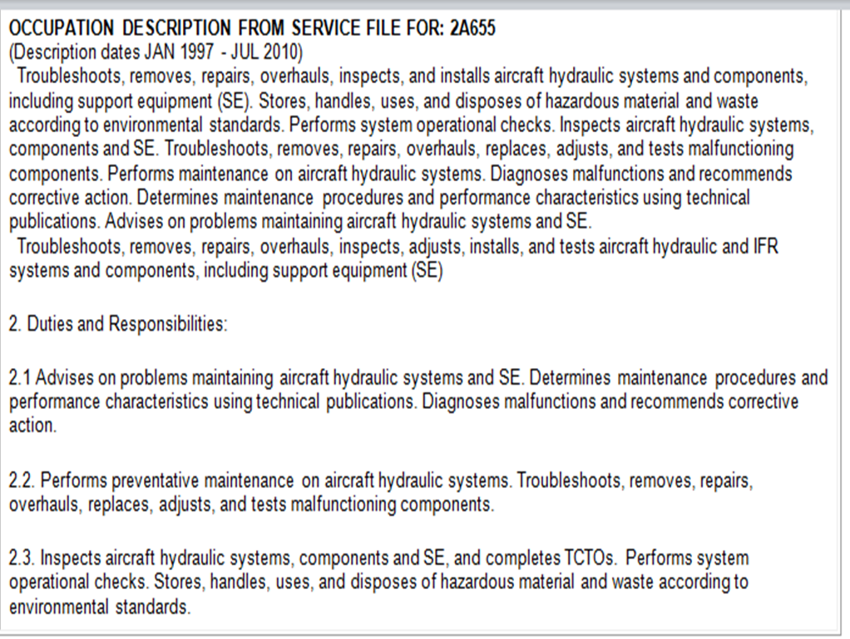
Sample VMET

Slide 9
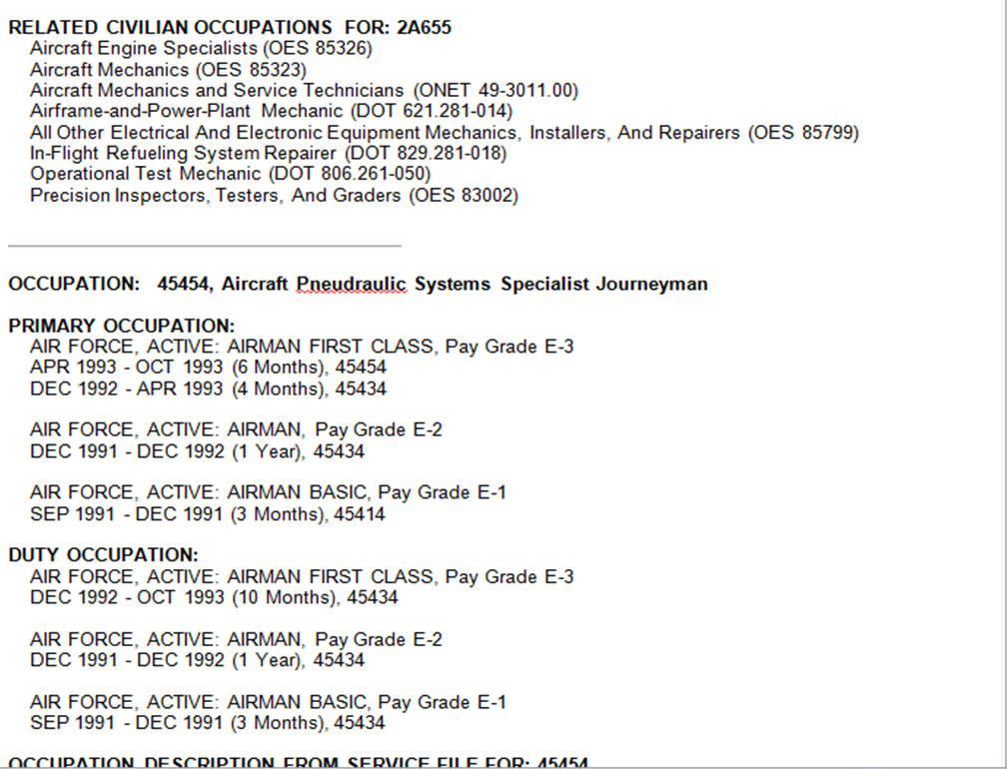

Slide 10
Crosswalk Example

Slide 11
VMET Exercise
1. Supervises personnel performing keyboarding, general clerical, and administrative duties; distributes work load; reviews and edits correspondence; sets up and reviews files; controls duplicating facilities; plans and organizes office operations; determines requirements for office equipment, supplies and space
2. Serves as a team leader, directing deployment and employment of personnel; supervises maintenance and construction activities, reads, interprets, and collects intelligence information; distributes administrative and training docs; trains subordinate personnel

Slide 12
Tools for Transition
Service Transcripts
Sailor and Marine American Council on Education Registry Transcript (SMART)
Army American Council on Education Registry Transcript (AART)
Community College of the Air Force (CCAF)
Notes:
PG-13 These resources may overlap with Verification of Military Experience and Training (VMET).
NOTE: Army officers need to refer to the Officer Record Brief (ORB) and/or the Officer Evaluation Report (OER) for work experience and a narrative description of duties performed. All other Officers may also find the ORB and OERs helpful. Army Reserve Officers currently do not have official ORBs and utilize the Personnel Qualifications Record (PQR) DA 2-1.
Bridging opportunity for education track. Remind participant to ask for further assistance in education track.
Time: 30 minutes for ALL tools depending on classroom connectivity.
Facilitator Note: There are many tools available to help you identify credentials, education, and experience requirements. We have tried here to offer the best tools for crosswalking your information to the civilian sector.
SMART: https://smart.navy.mil/smart/welcome
AART: https://aartstranscript.army.mil
CCAF: http://www.au.af.mil/ccaf/transcripts.asp

Slide 13
Credentialing
Licensure
Certification
Apprenticeship
Credentials:
May be required by law or by an employer for entry into employment
Lead to higher pay or improve prospects for promotion
Demonstrates to civilian employers that training and skills attained in the military are on par with those gained through traditional civilian pathways.
Notes:
PG 15 - Sometimes when drafting a crosswalk, multiple credentials are shown. There can be 20-30 related credentials to specific occupations. You will need to do research for the specific occupation and look at job listings to determine specific requirements.
(Slide 10-11: 10min)
NOTE: Credentialing can cost money.

Slide 14
Types of Credentials
Credentials
Licensure
Apprenticeships
Notes:
PG 14
Facilitator: Explain the main types of credentials and their differences.
It is important to note the difference between certification programs and certificate programs:
Certification programs attest to demonstrated competency in an occupational area. They typically have recertification requirements that might include continuing education units.
A certificate program, on the other hand, is a training program on a topic for which participants receive a certificate after attendance and/or completion of the coursework. These certificates typically don’t convey competency.
Apprenticeship – A registered apprenticeship program is an industry based approach to training that combines paid on-the-job learning with job related education. It is a written plan to move an employed apprentice from low or no skill level to the full performance level for occupationally identified skill sets. The program must meet program parameters established under the National Apprenticeship Act, administered by the U.S. Department of Labor’s Office of Apprenticeship or a Secretary of Labor approved State Apprenticeship Agency.
Army National Guard and Army Reserve Spouses may qualify for Federal educational benefits, i.e. DANTES (see your educational services officer).
All spouses and dependents eligible for OASC on DANTES website.

Slide 15
Influences on Career Selection
LMI
Location
Notes:
PG 17
(Slide 12-13: 5min and 10min break suggested)

Slide 16
Influences on Career Selection
Two Major Influences on Career Selection
Geographic Location | Labor Market Information (LMI)
Determine your potential priorities: Pursuing a location without your desired profession Pursuing your profession regardless of location Identifying an alternative profession because of your selected location | LMI can help you: Understand today’s complex workforce Explore civilian occupations based on employment levels and trends Make informed career decisions
Research/explore which geographic locations: Cost of living and finding housing Moving costs Family relocation Reserve Component – continuum of service | Research/explore: National, state, and local employment statistics, job forecasts, wages, and demographics A military skills translator to identify a civilian occupation LMI data and compare geographic areas
Notes:
PG 18 - Facilitator Transition: Now that we’ve explored the resources that can assist you in determining your appropriate path, let’s look at some of the influences on career selection.
Facilitator Note: Emphasize that Reservists may need to consider interstate transfer & unit logistics as part of their geographic decision.

Slide 17
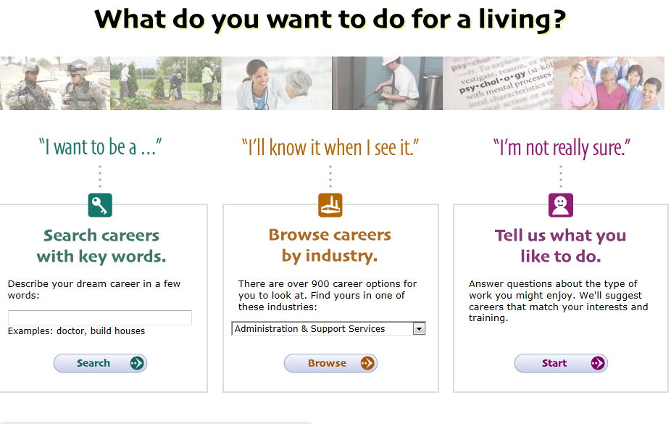
O*NET
Start
Notes:
Slide 14-15: Allocate 25min for completion of assessment (or longer if using hard copy).
PG- 19 UPDATE new snap shot of O*Net HOME website. Facilitator Note: Good resource links to O*NET and VA sites at bottom of screen and a resource for exploring occupations before the MOC Crosswalk.
Demonstrate: use the bottom link “My Next Move for Veterans” which is also on O*NET homepage
PPT Deck:
Main Screen
Occupational descriptors
Credentials
Job Banks
Job Listing
Applying Directly
Interest Profiler
Profiler Expanded
See last slide for supplemental information.

Slide 18
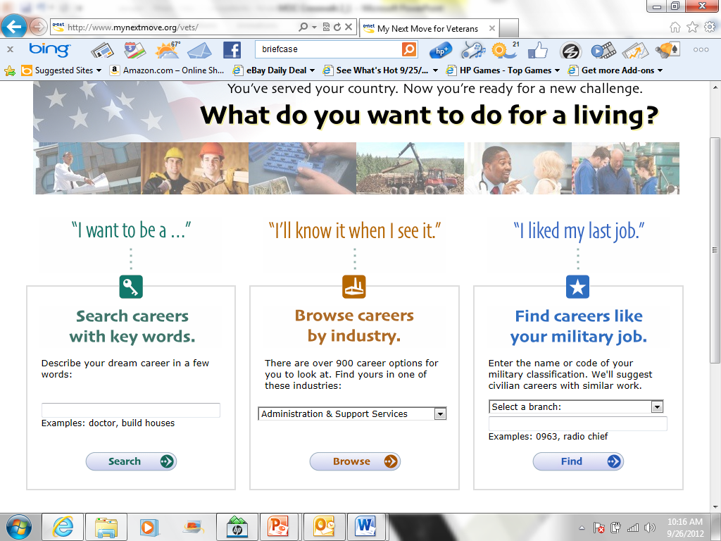
O*NET: My Next Move for VETERANS
Notes:
PG 19 –This is the home page view of the O*NET.
Facilitator Note: Discuss O*NET on the next slide.

Slide 19
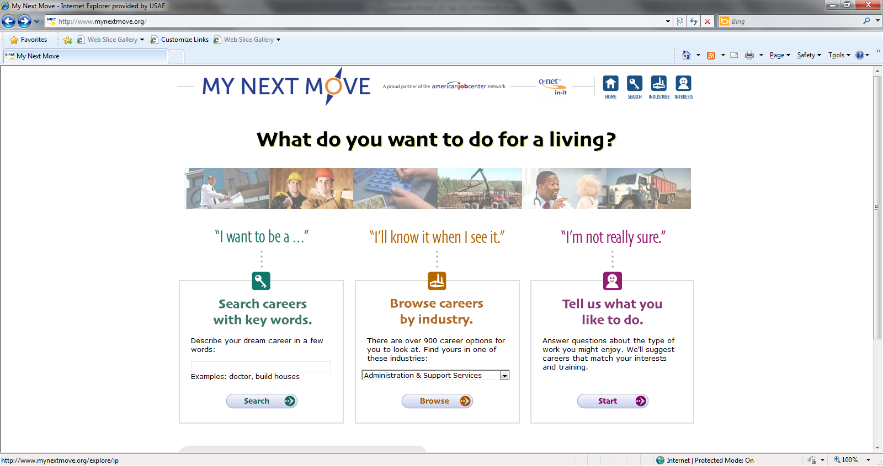
O*NET
Several of similar screens follow
Notes:
For paper version (PDF documents of interest profiler)

Slide 20
My Next Move/Interest Profiler
Complete profiler: mynextmove.org/explore/ip
Scott Ed Ctr has the following tools to assist in indentifying your interests in regard to the world of work:
Holland’s Self-Directed Search (SDS)
2) Career Assessment Inventory (CAI)
3) Campbell Interest and Skill Survey (CISS)

Slide 21
GAP Analysis

Slide 22
Additional Resources
Additional Resources
VETSUCCESS.GOV
VA For VETS: www.VAforVets.va.gov
Hero2Hire (H2H): www.h2h.jobs
Army COOL: www.cool.army.mil
Navy COOL: www.cool.navy.mil
Bureau of Labor Statistics: www.bls.gov
Notes:
Click on each link and show them what’s on the homepage
VETSUCCESS links them to all of the above except BLS:
On BLS….demonstrate use of Occupational Outlook Handbook

Slide 23
Summary
Department of Labor Employment Workshop (DOLEW) Track will help you further explore aspects to consider
Update your ITP with information you’ve researched
Note alterations to your track selection
Identify and pursue next steps in your transition process
Contact your local personnel office for accuracy of your official military record
Notes:
PG-26 – UPDATE to match PG
Facilitator Summary: (Slide 18-19: 5min)
Display competency PPT and learning objectives. Summarize what was covered in the MOC module.
Facilitator Note: The information reviewed in this module was an overview. There are a lot of other things to consider when looking for your next career. The DOLEW Track will help you further explore aspects to consider, and I encourage you to conduct research on your own to ensure you are making the most informed decision possible.
Final Note: Be sure to update your ITP with information you’ve researched and note any alterations you may have made to your track selection. Finally, identify and pursue the next steps you need to take in your transition process.

