Slide 1

Resumes for the 21st Century
Dr. Mary M Rydesky
ASD Engage & Inspire
Professional Learning Summit
November 2022

Slide 2


Agenda
How the digital age changed the workplace
Why one resume is now dangerous
What to do before preparing a resume or application
Points to make in the classroom

Slide 3


Introduction
Remember times before the Internet?
Local paper listed jobs
Resumes 1 – 2 pages long
Write one, make 50 copies, distribute
Things have changed!
Notes:
1482 De Vinci wrote the first professional resume

Slide 4




The way we work
Device + Internet
Career management starts early in life & changes with technology’s advances
Notes:
Our students have been influenced by computers and the internet from the beginning of their lives.
In 1821, Charles Babbage created a steam-driven machine that could compute and in 1848 Ada Lovelace wrote the first computer program
In 2001 the Mac changed computing ‘for the rest of us’, and the iPad appeared in 2010 (the Chromebook was added in 2011)
Alaska was an early adopter, and in 1999 two fiberoptic cables EXPANDED its use in the state. While we still lobby for faster service and lower costs today, nearly all Alaskans have Wi-Fi for access on mobile devices ranging from watches and phones to notebooks, laptops, and large monitors.
Earlier in my career, I worked for a company that partially owner Monster.com, the first online job search board and the first public resume database. Monster was founded in 1994, or 23 year ago. And today, we have countless job boards for searching and far more concern about privacy and security! (https://bebusinessed.com/history/history-online-job-search/)
So. What we teach our students has to incorporate new searching sites, Boolean logic and search algorithms, critical thinking about privacy and security, and
One other historical note concerns the development of a class of software called Applicant Tracking Systems, or ATS software. Consider 1998 as the birthdate of this invention and know that today, it is key to our understanding of how to get from desire for a job to the point of scheduling an interview. By 2006, aggregators – or sites that would crawl other job boards and combine them for one-stop searching – dominated. Today, a job seeker is easily overwhelmed about WHERE to look. (https://bebusinessed.com/history/history-online-job-search/)
How we we get them from the goal-oriented long view to reaching the peak, whether that is the interview, or the first day of a job?

Slide 5
Before Applying -1-
Maintain a Life Story
Lesson
History of from age 9 onward
Jobs, volunteering, clubs, awards & recognition, courses & grades
Capture ALL accomplishments
  Not assignments or duties
Develop self esteem through listing the many experiences a student has had
Comprehensive recollection = flexibility when looking at various jobs
Proofed entries = efficient resume writing
Save & Grow
Notes:
Google Jobs is taking over - it crawls company websites and other job boards, combining its findings in one place for users’ convenience
If the results are too many, teach how to narrow the scope:
Consider industry such as
Restaurants & hospitality
Sales & retail
Target by employer or company type
Sephora or Ulta
Toiletries
.

Slide 6

Before Applying -2-
Analyze the Job Ad
Lesson
Requirements/Qualifications
KSAOs
  Find every clue about an employer’s desired knowledge, skills, abilities, tech skills, and personality/work habits
Create a 2-column table
  Left – list what employer SEEKS
  Right – list what student OFFERS
Use the Zipper analogy
Outline resume contents
Notes:
Google Jobs is taking over - it crawls company websites and other job boards, combining its findings in one place for users’ convenience
If the results are too many, teach how to narrow the scope:
Consider industry such as
Restaurants & hospitality
Sales & retail
Target by employer or company type
Sephora or Ulta
Toiletries
.

Slide 7
Job Finding
Google is the New Aggregator
Lesson
“jobs near me”
Past 3 days
Part-time
No degree
Develop search strategy to find 5+ jobs
In new tab, go to the company having the job of interest
  Find Jobs or Careers
120+ jobs
Notes:
Google Jobs is taking over - it crawls company websites and other job boards, combining its findings in one place for users’ convenience
If the results are too many, teach how to narrow the scope:
Consider industry such as
Restaurants & hospitality
Sales & retail
Target by employer or company type
Sephora or Ulta
Toiletries
.

Slide 8
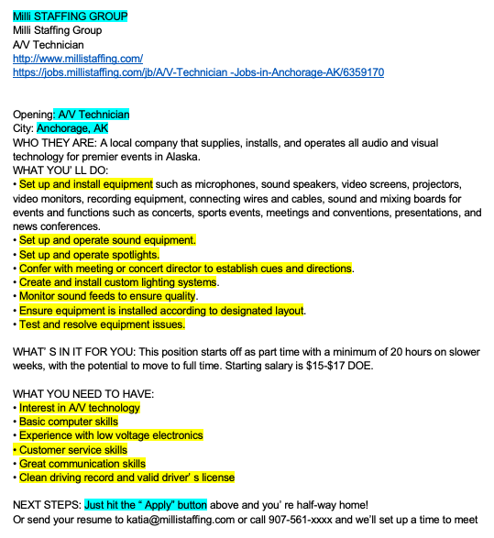
Analyzing a Job Ad Today
Notes:
Copy ad from a company website into a document
Read for overview.
Read for the who – what – where- when –how – why – highlighted in blue
Read for the KSAOs – highlighted in yellow
Read for the keywords – circled in red (not completely done!

Slide 9
How a Zipper Might Look Today
You Seek | I Offer
Set up and install equipment such as microphones, sound speakers, video, cables, sound and mixing boards for events and functions such as concerts, sports events, and conferences. | Set up and install equipment such as Midas and Behringer digital mixer, Mackie speakers, da lite screens,, zoom, audition recordings, mixing analog and digital 32 channel mixers for 31 live, concerts, sports events, and conferences
Set up and operate sound equipment. | Set up and configure stage boxes and routing for digital and analog mixer within ear mix’s and or floor monitors for event, with wireless or wired mic’s
Set up and operate spotlights. | Can set up and operate spotlights.
Confer with meeting or concert director to establish cues and directions. | Confer with the director to establish to cues and directions
Create and install custom lighting systems. | Go through lighting tutorials online and research what systems are available
Monitor sound feeds to ensure quality. | Monitor sound feeds to ensure quality
Ensure equipment is installed according to designated layout. | Ensure equipment is installed according to designated layout.
Test and resolve equipment issues. | Test and resolve equipment issues.
Interest in A/V technology | Extreme Interest in computer, A/V technology since I was plugging in electronics since I was 5
Basic computer skills | Able to set up computers and or fix for what user need or what is needed to do the task at hand
Experience with low voltage electronics | Soldered XLR cables (low voltage electronics) for speaker and building computers
Customer service skills | Customer service skills, able to work with user to find best solution for the problem they have at hand
Great communication skills | Great communication skills ability to work with client to find best solution to solve problems
Clean driving record and valid driver’ s license | Clean driving record and valid driver’ s license renewable on 09/03/2023

Slide 10
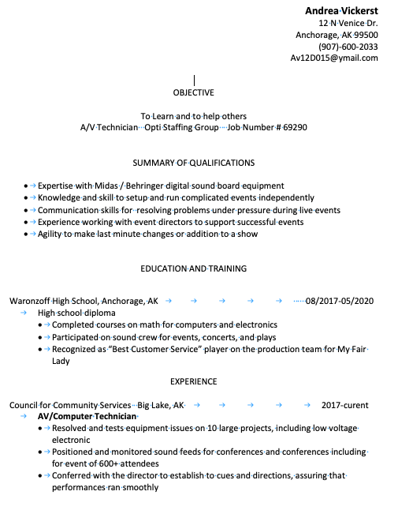
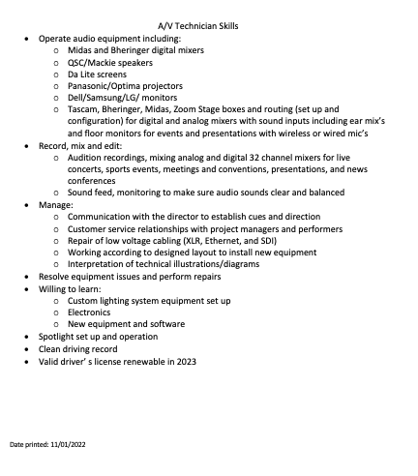
How a Resume Might Look Today

Slide 11
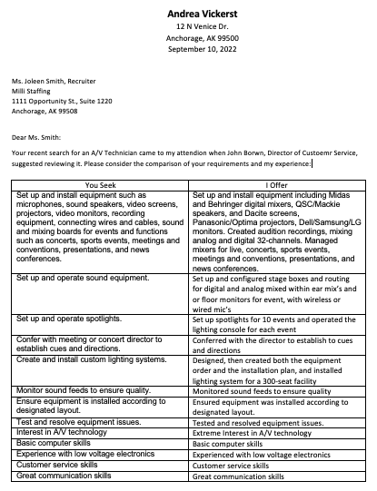
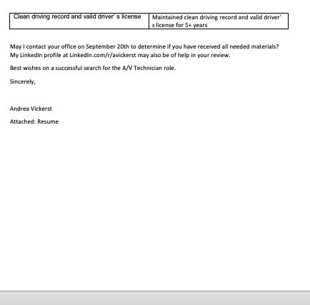
How a Cover Letter Might Look Today

Slide 12

What Happens
After You Apply?
200 – 250 applications
#1 Rule: FTD
ATS
(match KSAOs & keywords)
3-Second Screen (Errors)
11-Second Screen
Read
= 2%
4 – 5 interviews
Notes:
Here is a diagram of the HR process today.
First steps are completely digital
With the average online job posting receiving 250 resumes, only a small percentage of applicants will get an interview. Since most employers interview fewer than 10 candidates for a position, only 2-3% of applicants will receive an interview on average. There are exceptions, however. If a job is not posted online and you found it through networking or through talking to an employer directly, your odds are much greater.
If someone refers you to the hiring manager and recommends they speak with you, then your odds are also much greater. (https://careersidekick.com/interviews-per-job/)

Slide 13
And the Interview Winners…
Complete, THEN Concise
Format Vertically, No Cute Stuff
Match all KSAOs
KSAOs
  knowledge, skills, abilities, tech skills, & personality/work habits
  Start each with a past tense verb to tell when/where/how much
Create a 2-column table
  Left – list what employer SEEKS
  Right – list what student OFFERS
Use the Zipper analogy
Gone: The Two Pager & the Attractive Template
Notes:
Google Jobs is taking over - it crawls company websites and other job boards, combining its findings in one place for users’ convenience
If the results are too many, teach how to narrow the scope:
Consider industry such as
Restaurants & hospitality
Sales & retail
Target by employer or company type
Sephora or Ulta
Toiletries
.

Slide 14
Some Things Have Stayed the Same
Contact Information (No Street/Apt)
Objective (Name of the Company – Job Title – Job Ad #)
Work Experience
Education/Training
Community Service/Volunteering
Clubs/Sports/Extracurriculars
Awards/Recognition
Special Skills (Optional)
In Life Story in detail
In resume as needed
for the zipper
Notes:
The student should keep a file with all information about each of these categories from their teen years onward. Some call this an autobiography or a master – it never goes to others but is a ‘cupboard’ of personal history. Take out just the statements that fit the zipper when applying for something in particular.

Slide 15

The way to get started is to quit talking [90’s style] and begin doing [2020’s style].
Apologies to Walt Disney

Slide 16
What Else is Being Automated?
Resume Screening
Follows directions
Demonstrated analysis of our needs
Is detail oriented
Deception analysis (like plagiarism)
First Interview
Conducted by a ‘bot’
Person records answers which are transcribed & run through the ATS
Assesses identity of writer
May be followed by ‘Zoom’ interview
References
Conducted via an online questionnaire
Offer
The offer may be altered based on the number of months of experience noted on the resume
Employee Lifecycle
History from application – candidacy – hiring – training - through end of employment

Slide 17



Lessons
Business Axiom:
Digital Skills
Focus on Achievements
Word processing skill
Cyber security
Apply tools like Grammarly, WriteWord, Word cloud for checking quality
Communicate with digital comm tools like Zoom, texting, video recording
#TikTokResumes, Instgram resumes, etc.
Its what you did, not what you were assigned.
Measure your achievement – add metrics
Measure traits such as reliability, attendance, communication skill, problem solving , too
HR is #1 expense
Cutting cost is good business
HR cost reduction is highly valued
Notes:
Intagram Resumes https://www.entrepreneur.com/science-technology/3-ways-to-transform-your-instagram-into-your-resume-and/392200

Slide 18




Summary
Wherever the students head, their futures include making a living in order to fund their dreams.
Teaching students modern ways of getting jobs is the teacher’s investment.
Learning how technology has changed business processes is important to both teachers & students.

Slide 19


Thank you for always learning!
Mary M. Rydesky
mrydesky@yahoo.com
www.transitionmangement.us

Slide 20
Administrivia
Attendance Link
Session Feedback Link
https://bit.ly/engage22attend
https://bit.ly/engage22feedback
Speaker’s LinkedIn Link
https://www.linkedin.com/in/mrydesky/

