Slide 1

Resumes
Mary M Rydesky
Transition Management
Wayland Baptist University
Student Chapter/SHRM
2015
Notes:
Use of images limited to classroom presentation for student chapter of SHRM at WBU.

Slide 2
History
http://www.businessinsider.com/how-resumes-have-evolved-since-their-first-creation-in-1482-2011-2?op=1
Notes:
http://www.businessinsider.com/how-resumes-have-evolved-since-their-first-creation-in-1482-2011-2?op=1
1482

Slide 3
Leonardo’s Original

Slide 4


An Apology
Notes:
Lets dispense with the concept of resumes. The resume is held to a standard of something one can take with to dispense at job fairs, something to tweak for application purposes, and something of value in job hunting but overlooked in education and entrepreneurial pursuits. The resume is antiquated but we persist in encouraging its devotees to limiting it no more than two page filled with expression of what we think is most laudable about our endeavors.
So to that, I I toss an old fashioned epithet: balderdash.

Slide 5

The New Millennium
Notes:
Today, may I offer an alternative? May I invite you to retool your skills? If you accept, know that we will start from the perspective of the very big picture. We will construct a new context and I will sound like I am delivering a class in business management, or perhaps entrepreneurial thinking. With that back drop, let's re-engineer the purpose of your personal marketing and focus on your target, your goal, your intended outcome. In true systems thinking, we can then assess the gap between where we are and where we want to be - and with that clearly defined, we will dive into persuasive communications.
And the result? I will suggest a replacement for the resume. Something that is like a heat seeking missile. Something that is quick to assemble once you have amassed the raw goods, something that is customized to and delivered in the recipient's language.
Ready? In full disclosure, I must tell you that I teach this for DOL to DOD through a subcontractor relationship and students tell me that 3 8 hour days is not enough time to digest the concepts let a lone apply it. I suspect they would say the same if we met for three weeks - so beware, keep your pen in motion for notes, and keep your seat belt fastened.

Slide 6

Raw Goods
Notes:
The Raw Goods
Personal Mission Statement
Annual Goals & Objectives
Values & Vision - how do you live and what is your dream?
500 - 750 Skills
CLAMS
What does Where look like?
Your Career Management Plan: Three Chapters

Slide 7

Marketing & Branding
Notes:
Marketing and Branding
Brand (Reputation)
Brand Name
What do you Sell?
The 4 Ps (product place price promotion)

Slide 8

Channels
Notes:
Channels of Communication
Personal Business Card
PPF & Bio
Social Media
LinkedIn

Slide 9

Marketing
Notes:
Do you have the words to describe what you are selling in terms of skills with which to perform in a job?
Do you know the market value of someone who is appropriately experiences and educated for a job?
Do you know how these two are influences by the place in which the job is located?
Do you have a strategy for communicating what you can do to help a company reach its goals (promotion?)

Slide 10
Research (Ongoing)
Economy
Industry
Role
Notes:
Market Research: Identify elements that steer
Economy
Industries
Occupations
Sociology/population, demographics, legal regulatory, technology/innovation, economy, competition (market forces)

Slide 11
Research (Targeted)
Company
Competitors
Hiring Event
Notes:
Market Research: Identify elements that give clarity to the opportunity
Event – published or hidden

Slide 12
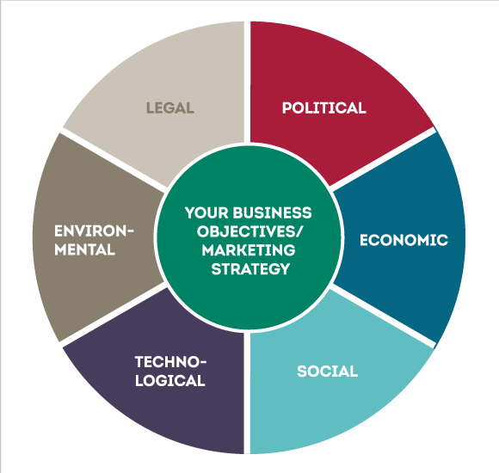
Research
Notes:
Market Research: Identify elements that steer
Economy
Industries
Occupations
Sociology/population, demographics, legal regulatory, technology/innovation, economy, competition (market forces)

Slide 13
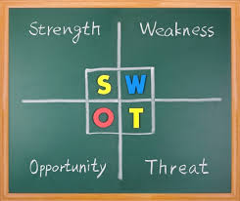
SWOT Analysis
Notes:
Note that when you have answers to the items above, you have a dimensional SWOT analysis, as SW looks inward to your company/you and OT looks outward to the marketplace. With this perspective - and it takes quite a few hours to build - you can create a resume replacement that might actually accomplish something.
But let me ask - what IS the measure of success with a resume?

Slide 14

Resume’s Purpose
Notes:
The resume has one purpose: getting the INTERVIEW.
So if this is the case, let us recreate the resume by redefining it and giving it a new name.

Slide 15

The New Resume

Slide 16
Sections
Contact Information
Objective
Summary
Work History
Education & Training
Awards
Professional Affiliations
Volunteer Affiliations
Notes:
A proposal is usually submitted in response to a request for proposal or RFP. In the hiring world, that RFP is often called the job announcement.

Slide 17
Sections - Customized
Skills/Technical Competencies
Functional History
Languages
Publications
Presentations
Research
Grants & Fellowships
Notes:
Sections of a proposal style of resume that customizes it

Slide 18
The Job Ad (RFP)
Read for facts
  Who, what, where, when, and how
  Why may take more research
Read for requirements & preferences
  KSAs
  Experience
  Education/certifications
  Miscellaneous
Read for keywords

Slide 19
Sections -1-

Slide 20
Sections -2-

Slide 21
Sections -3-

Slide 22
Sections -4-

Slide 23
Did You Notice?
Absence of italics, underlines, borders, lines
Use of bold for name & job titles only
Section headers centered in all caps not bold
Print date at bottom of last page (X of Y)
Accomplishment bullets ending in ‘ed’
Copious metrics
White space
Notes:
Why? Technology – scanners and ATS

Slide 24
Quality Control (QC)
MS Office Spell & Grammar Check
Backwards reading
Forwards reading
Content analysis
Keyword check with Wordle or TagCrowd
Keyword check with WriteWords
Metrics

Slide 25
Writewords.org.uk -1-

Slide 26
Writewords.org.uk -2-

Slide 27
Writewords.org.uk -3-

Slide 28
Wordle.net
Notes:
Save as a txt file and create a wordle.
Do same with the job ad.
Compare

Slide 29

But….

Slide 30

The New Resume

Slide 31
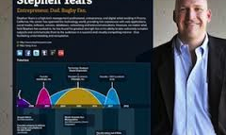
The Newer Resume
Notes:
Re.vu/mrydesky
http://re.vu/mrydesky

Slide 32
The Newer Resume -2-
Notes:
http://vizualize.me/mrydesky

Slide 33
Leonardo’s Today

Slide 34
Actions
Capture your product
  Master App – your history
  Business plan elements
Research continuously
Promote yours product via social media
Analyze the job ad
Copy & paste to create your one-time use proposal

Slide 35
Resources
www.transitionmanagement.us - Resources
Careerealism.org
Pinterest
SHRM
LinkedIn
Everyone with whom you can network
SlideShare version
Notes:
<iframe src="https://www.slideshare.net/slideshow/embed_code/key/tBvWn6fhKQ2fBD" width="476" height="400" frameborder="0" marginwidth="0" marginheight="0" scrolling="no"></iframe>

Slide 36

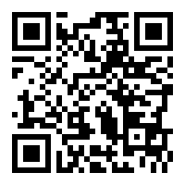
Questions?

